Slide 1

Full Stack Development
Administering Databases
P.SANJANA REDDY
22H51A05H4
CSE-D
S

Slide 2

Database administration is a crucial aspect of full stack development. It involves managing and maintaining databases, ensuring their efficient performance, and protecting them from security threats.
S

Slide 3


Importance of Database Management
1
Data Storage
2
Data Integrity
Databases store application data, enabling retrieval and manipulation. This is essential for functionality.
Database management ensures data accuracy and consistency, crucial for reliable applications.
3
Performance Optimization
4
Security
Database administrators optimize queries and database structures for fast data access.
Databases require robust security measures to prevent unauthorized access and data breaches.

Slide 4
Selecting the Right Database Technology
Relational Databases (RDBMS)
NoSQL Databases
Cloud Databases
Flexible data models, suitable for unstructured data. Examples include MongoDB, Cassandra, and Redis.
Hosted database services like Amazon RDS, Google Cloud SQL, and Azure SQL Database.
Structured data stored in tables. Examples include MySQL, PostgreSQL, and Oracle.
High scalability and performance
Managed services for ease of use
Data integrity and consistency
Suitable for large-scale data sets
Scalability and reliability
Strong querying capabilities
Evolving technology landscape
Cost-effective solutions
Well-established and mature

Slide 5

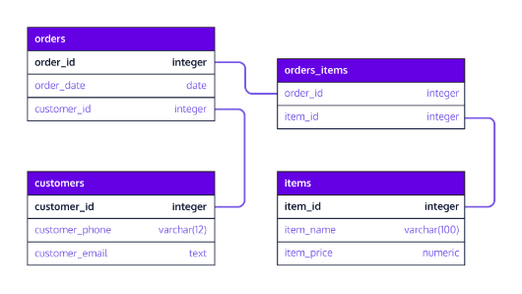



Designing and Implementing Database Schemas
Data Modeling
Schema Design
Implementation
Defining entities, relationships, and attributes of data.
Translating data models into a structured schema for the database.
Creating tables, columns, and relationships based on the schema design.

Slide 6

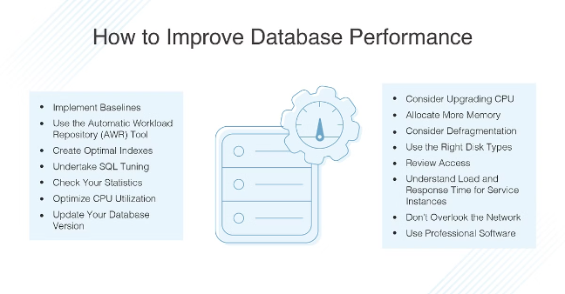
Optimizing Database Performance and Scalability
1
Query Optimization
Improving query efficiency through indexing, query rewriting, and caching.
2
Data Structure Optimization
Selecting appropriate data types, normalizing tables, and minimizing data redundancy.
3
Scaling Strategies
Employing techniques like horizontal scaling, sharding, and read replicas to handle increasing workloads.

Slide 7






Securing and Protecting Database Assets
Firewall Protection
Access Control
Restricting access to the database server from unauthorized networks.
Implementing user authentication and role-based access control.
Data Encryption
Regular Auditing
Encrypting sensitive data both at rest and in transit.
Monitoring database activity and identifying suspicious patterns.

Slide 8


Backup and Recovery Strategies
Full Backup
Complete copy of the database, including all data and log files.
Differential Backup
Only backs up changes since the last full backup, reducing backup time.
Incremental Backup
Backs up only the changes made since the last incremental backup.

Slide 9

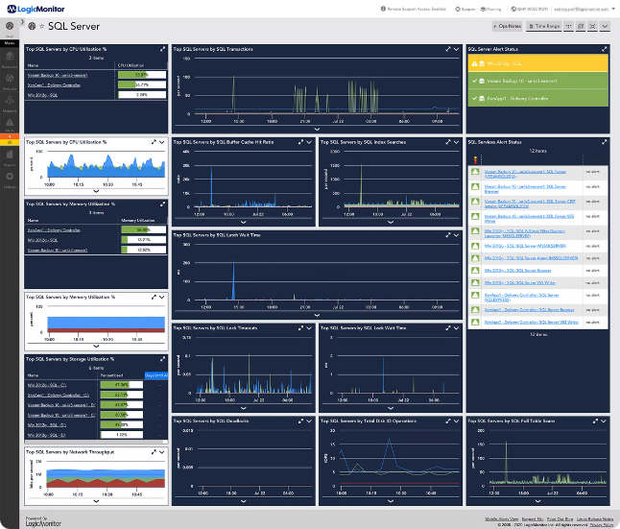
Monitoring and Troubleshooting Database Issues
Performance Monitoring
Error Logging
Analyzing error logs to identify and troubleshoot database issues.
Tracking key metrics like query execution times, database load, and resource usage.
Alerting
Setting up alerts for critical events like database failures or performance degradation.

Slide 10
Conclusion
Administering databases is a vital task that involves ensuring data integrity and security, which includes implementing access controls, encryption, and regular audits to protect sensitive information. A robust backup and recovery plan is essential to prevent data loss and enable swift restoration in case of any failures. Performance optimization is another key aspect, requiring continuous monitoring and tuning to maintain database efficiency. As databases grow, planning for scalability becomes crucial to handle increased loads without compromising performance. Compliance with regulations and thorough documentation of database configurations and changes are necessary for accountability and troubleshooting. Additionally, administrators must consider end-of-life scenarios, planning for smooth migrations or upgrades when systems become outdated. Finally, staying updated with new technologies and practices through continuous learning is essential to remain effective in the ever-evolving field of database administration.

Slide 11


